Slide 1






Many universities and hospitals are now enforcing policies on personal data protection that in reality prohibit publication

Slide 2
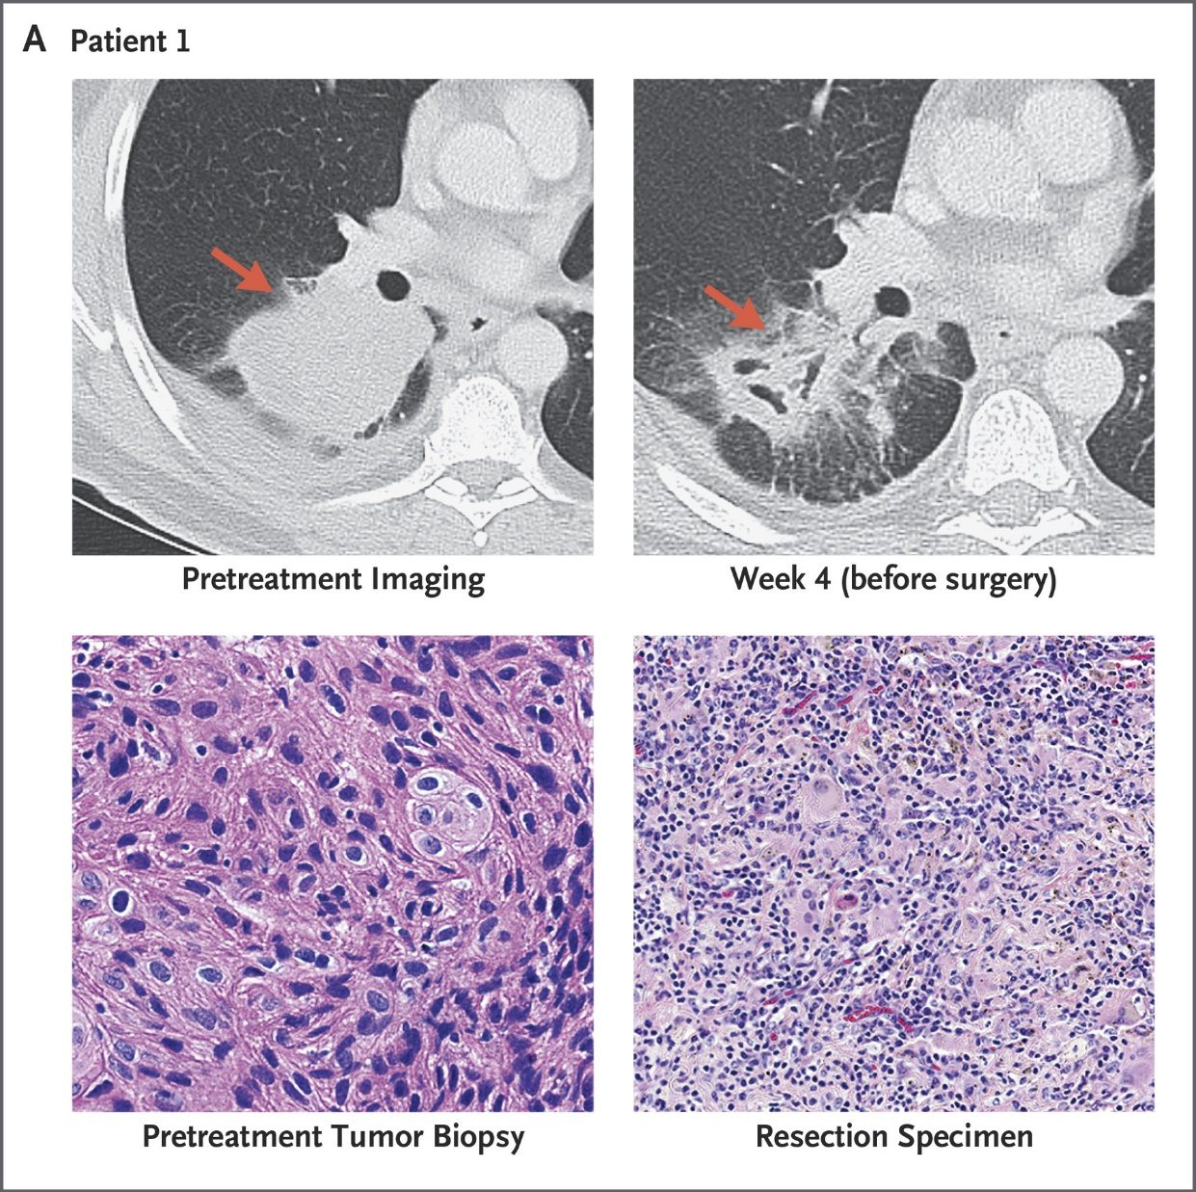

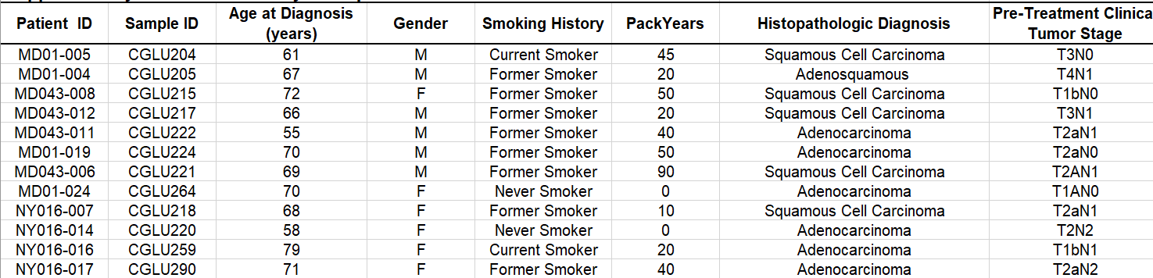
Research articles are full of pseudonymised data
Patient names are replaced with codes. Datasets often contain information extracted from medical records

Slide 3
GDPR defines pseudonymized data as personal data
Data controllers who choose to pseudonymise data, rather than anonymise them, must be aware that the data will still be defined as personal data, and must therefore be processed in accordance with the Personal Data Act’s provisions.
Thus, as long as if there is a link to directly identifiable data somewhere, the information is regarded as personal data.
https://www.datatilsynet.no/en/regulations-and-tools/guidelines/anonymisation/

Slide 4
Major Norwegian research institutions define pseudonymised data as «sensitive»
-Personal data should be processed in a controlled system.
-Information regarding health must in practice be processed on equipment owned by the hospital, alternatively, there must be a data processing agreement.

Slide 5
Researchers often experience trouble when asking for permission to share data
Oslo University Hospital Data Protection Officer (OUH-DPO) May 4. 2018:
-It is important that indirectly identifiable personal data are not released from the hospital in context of publication.
OUH-DPO 2018 Draft for SOP for publication:
-A data processing agreement must be in place before data are released to an external partner (i.e a journal). The journal must enforce controlled access to data for authenticated individuals only.
UiO web for employees:
-When UiO releases data to external parties [such as journals], a data processing agreement is mandatory.

Slide 6
The ethical commitees have similar regulations
Helse-Sør Regional Ethical committee standard formulation for letters of consent:
“If pseudonymized data are to be shared outside of EU, the researchers must specify the countries.”
However, once the data are published, they are available to anyone in the world who has access to NJEM and other journals.

Slide 7
Scientific journals cannot offer data processing agreements
New England Journal of Medicine is accessible to anyone located in Norway. Access is paid for by the Norwegian Government.

Slide 8


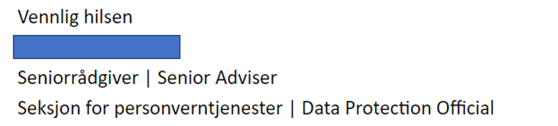
The DPO Official for all Norwegian universities (NSD), believes that reserachers delete keys to connect pseudonyms to direct identifiers prior to publication.
“Is it really true that there is typically a link between published data and directly identifiable data?”
“Again, I hesitate to believe that the key-codes are stored. Thus, I doubt that publication of pseudonymized data is a relevant problem in research. “

Slide 9
The string of information in published tables is often unique for the individual.
The pseudonym is therefore usually not required to re-identify individuals in medical records of research databases.

Slide 10

A good reason for not deleting tracks to original data
"He faked everything: names, diagnosis, gender, weight, age, drug use," Stein Vaaler, director of strategy at Oslo's Radium hospital, said. "There is no real data whatsoever, just figures he made up himself. Every patient in this paper is a fake.

Slide 11
Did the EU intend to end research as we know it?

Slide 12

The EU funds one of the world’s largest databases with content of pseudonymised data
At EMBL-EBI, we make the world’s public biological data freely available to the scientific community https://www.ebi.ac.uk/about
EMBL deems its updated framework on data protection to be ‘adequate’ in the sense of GDPR. (http://www.embl-hamburg.de/aboutus/administration/legal-services/data-protection)
As part of the European Molecular Biology Laboratory (EMBL), the largest part of our funding comes from the governments of EMBL’s member states. (https://www.ebi.ac.uk/about/funding)

Slide 13
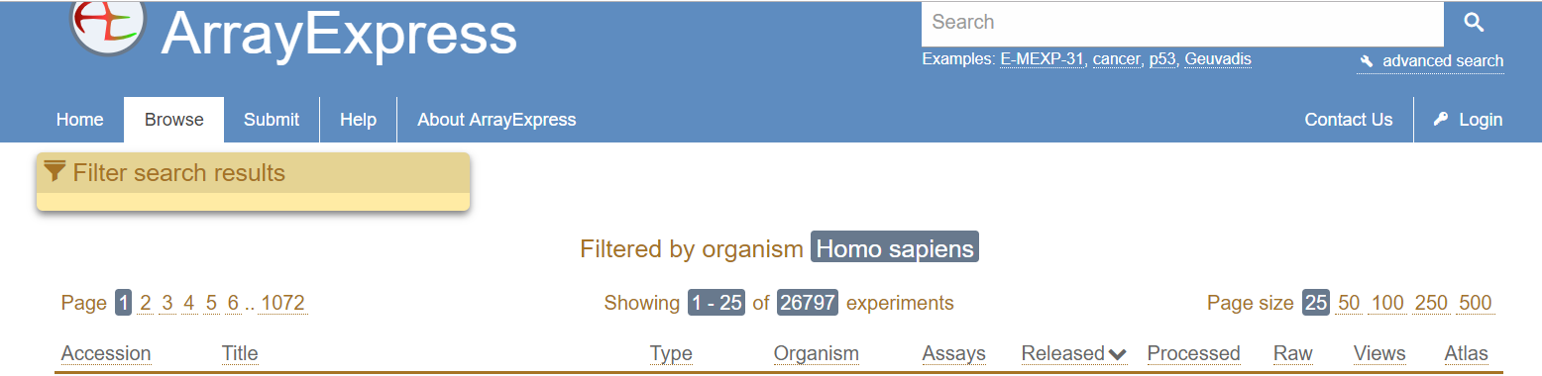
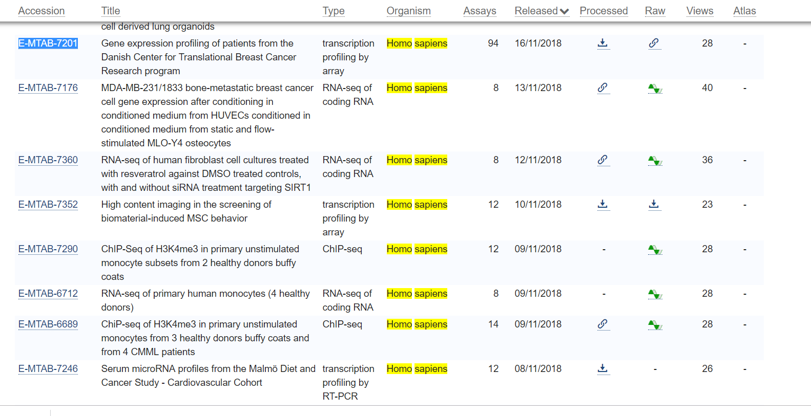
EMBL-EBI Array express contains 26.000 datasets from studies on human subjects. More are added every day.

Slide 14
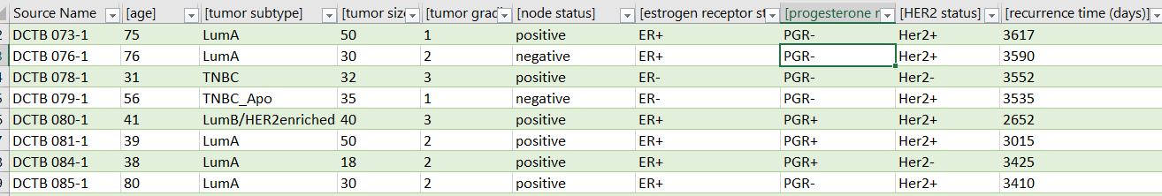
The datasets contain detailed information about diagnosis and patient outcome

Slide 15

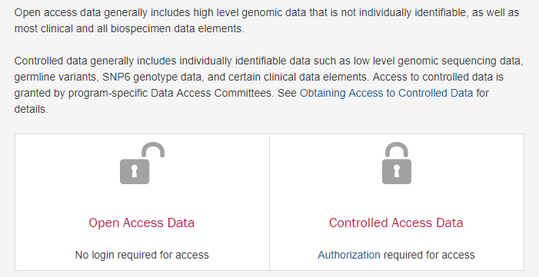
USA has similar efforts.
Lund-Johansen 15
https://gdc.cancer.gov/access-data/data-access-processes-and-tools

Slide 16

EU emphasizes the need for general access to data
Lund-Johansen 16
http://ec.europa.eu/research/openscience/index.cfm?pg=openaccess
“It is now widely recognised that making research results more accessible to all societal actors contributes to better and more efficient science, and to innovation in the public and private sectors The Commission therefore supports open access at the European level (in its framework programmes), at the Member States level and internationally.”

Slide 17

Open access to data is mandatory in the Horizon programme.
Lund-Johansen 17

Slide 18
EU’s intention
Lund-Johansen 18
It seems clear that EU’s intention is to provide the general public with access to data from medical research.

Slide 19
What does the Norwegian law say?
Lund-Johansen 19
Norway passed a new law on data protection that incorporates the GDPR
Does the GDPR prohibit publication of pseudonymized data?

Slide 20
GDPR artikkel 89 specifically mentions pseudonymisation as a measure for data protection.
GDPR Art 89: https://gdpr-info.eu/
Lund-Johansen 20
1
Processing for archiving purposes in the public interest, scientific or historical research purposes or statistical purposes, shall be subject to appropriate safeguards, in accordance with this Regulation, for the rights and freedoms of the data subject.
Those safeguards shall ensure that technical and organisational measures are in place in particular in order to ensure respect for the principle of data minimisation.
Those measures may include pseudonymisation provided that those purposes can be fulfilled in that manner.
Where those purposes can be fulfilled by further processing which does not permit or no longer permits the identification of data subjects, those purposes shall be fulfilled in that manner.

Slide 21
Pseudonymization is more than just removal of names and social security numbers
Lund-Johansen 21
GDPR Article 4 https://gdpr-info.eu/art-4-gdpr/
pseudonymisation’ means the processing of personal data in such a manner that the personal data can no longer be attributed to a specific data subject without the use of additional information, provided that such additional information is kept separately and is subject to technical and organisational measures to ensure that the personal data are not attributed to an identified or identifiable natural person;

Slide 22
Most types of data that are published in journal articles give low risk for re-identification
Lund-Johansen 22
Many types of data are obtained by special methodology. The results are usually not sent to the individual. They can therefore not share the data on e.g. social media.
Few patients share their medical records on social media
Directly identifiable information such as genome sequencing data are not released in publications, but stored securely.

Slide 23
Publication is a common form of “data processing” in research.
‘processing’ means any operation or set of operations which is performed on personal data or on sets of personal data, whether or not by automated means, such as collection, recording, organisation, structuring, storage, adaptation or alteration, retrieval, consultation, use, disclosure by transmission, dissemination or otherwise making available, alignment or combination, restriction, erasure or destruction;
https://gdpr-info.eu/art-4-gdpr/

Slide 24
GDPR recital 26 may define certain types of pseudonymised data as anonymous https://gdpr-info.eu/recitals/no-26/
The principles of data protection should therefore not apply to anonymous information, namely information which does not relate to an identified or identifiable natural person or to personal data rendered anonymous in such a manner that the data subject is not or no longer identifiable.
To ascertain whether means are reasonably likely to be used to identify the natural person, account should be taken of all objective factors, such as the costs of and the amount of time required for identification, taking into consideration the available technology at the time of the processing and technological developments

Slide 25
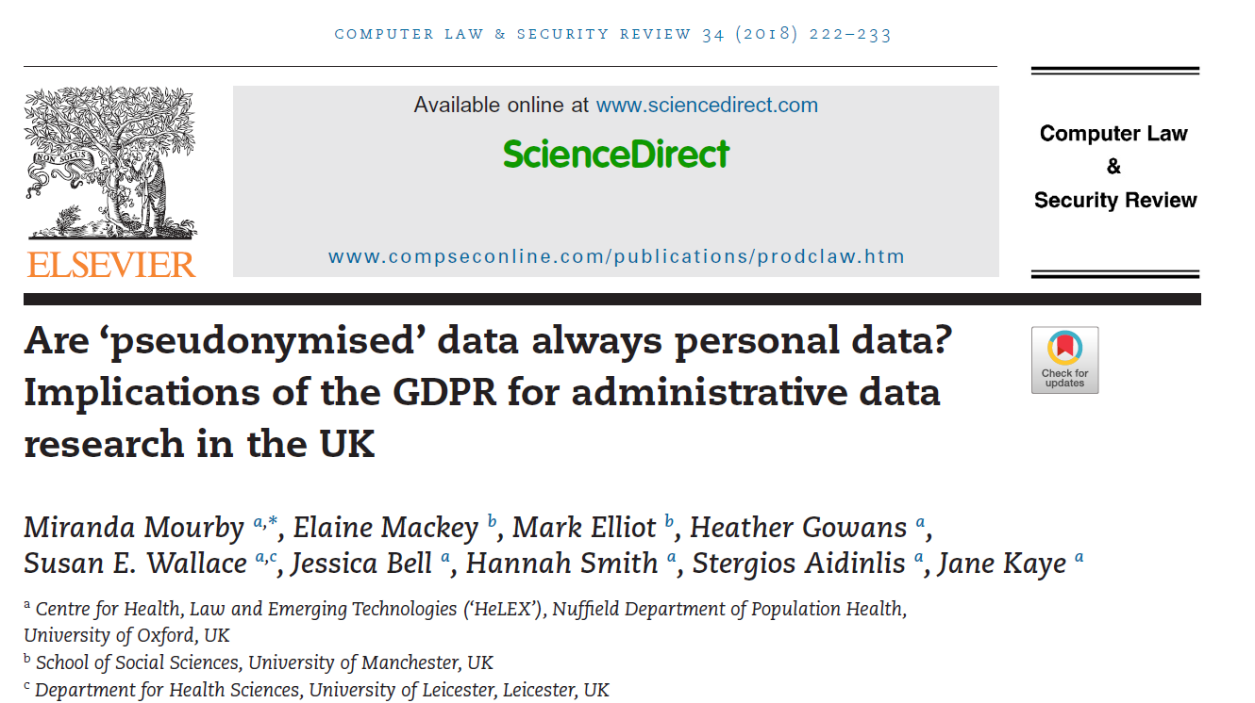
A CJEU decision may open for a liberal interpretation of Recital 26
https://doi.org/10.1016/j.clsr.2018.01.002
“They concluded that the data were personal, but only because of the existence of legal channels enabling the competent authority to obtain identifying information from the internet service provider in the event of a cyber-attack.²⁵ In the absence of these channels, the data would not have been considered personal simply because a known third party could identify them”

Slide 26
The «Breyer case»
The definition of «personal data» is relative.
The key point is if an individual has legal access to information that can be used to re-identify the subject.
Norwegian law binds researchers to confidentiality.
The implication is that the researchers knowledge about data subjects is not a legal source for a third party to re-identify the subjects.
Links to discussions about the Breyer Case:
Advokatfirma Bird&Bird
EU Law Analysis

Slide 27
The consequence of the Breyer case is that the data processor should determine if research subjects can be reidentified from data that are legally accessible for a third party
https://www.datatilsynet.no/en/regulations-and-tools/guidelines/anonymisation/
«Motivated Intruder Test»
This involves testing whether the data can be re-identified if an intruder should attempt to do so.
In other words, they [the motivated intruders] have access to resources such as the internet, public databases and libraries. It must also be presumed that they will be able to use various investigative techniques to communicate with people who know the identities of individuals in the data set. However, the motivated intruder should not be deemed to have specialist knowledge, such as expertise in data hacking, or access to specialist equipment to force access to data that is securely stored.

Slide 28
Art. 39 GDPR
Tasks of the data protection officer
GDPR specifies that Data Protection Officers must have deep knowledge about the particular type of processing conducted in their institutions.
Lund-Johansen 28
The data protection officer shall in the performance of his or her tasks have due regard to the risk associated with processing operations, taking into account the nature, scope, context and purposes of processing.
(Recital 97): The necessary level of expert knowledge should be determined in particular according to the data processing operations carried out and the protection required for the personal data processed by the controller or the processor
https://gdpr-info.eu/art-39-gdpr/

Slide 29
What a DPO in university setting must know:
Common data formats in journal articles (Tables, figures, supplementary data etc)
Legal basis for large data repositories that hold pseudonymized data (EMBL-EBI, GDC, ProteomeExchange etc)
Data types that are provided as open access or not in data repositories.
EU’s open research policy
Journal requirements for data availability
Laws for record-keeping in medical research (e.g. clinical trials).
Risk of re-identication associated with various types of data.
Rettspraksis for GDPR (bl.a. fortolkninger av dommen i “Breyer” saken)
Etablert praksis for samtykke (hvilken hjemmel gir REK sin mal for samtykkeskjema?)
Review prosess (anonyme reviewere får tilgang til upubliserte data).
Pre-print servere (uten review, forsker står selv ansvarlig)
Fordeler og ulemper ved aggregerte vs individ-baserte data.

Slide 30
The GDPR is really about risk-assessment
Secure storage
Data in public domain
Overlap with directly identifiable data in the public domain?
Directly identifiable data
Pseudonymised data
Publication
Yes
No
DPIA
https://gdpr-info.eu/art-35-gdpr/
https://gdpr-info.eu/art-63-gdpr/
https://gdpr-info.eu/recitals/no-135/

Slide 31

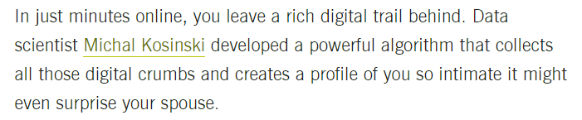
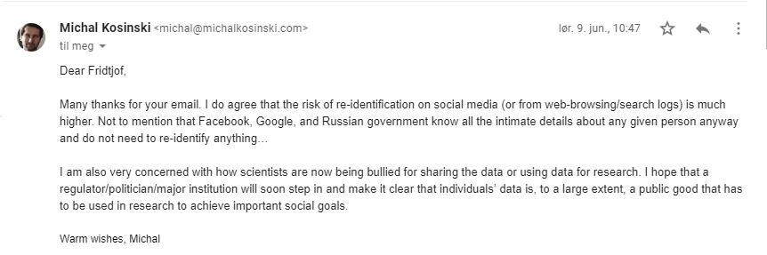
The risk for re-identification from published research data is probably negligible compared to that we expose ourselves to through our digital behaviour

Slide 32
Conclusions:
It is common practice to publish pseudonymised data in research articles.
GDPR 89 specifies pseudonymisation as means for protecting data subjects
Recital 26 in GDPR and the judgement in the «Breyer case» may even define some types of pseudonymised data to be outside of the regulation.
Scientific journals cannot sign data processing agreements since they are accessible to anyone with a subscription.
There is no reason to require data processing agreements when researchers share pseudonymised data prior to publication.

